Slide 1
PQAI 1 Seminar
Footprint Count Using Face Recognition
Presented By:
Name | Roll no.
Saloni Giratkar | 19
Nikita Parate | 39
Samruddhi Uplapwar | 37
Yashaswi Rewatkar | 35
Under the Guidance of
Dr. Yogita Chitriv(Dubey)
Collaboration with Ajmera Tyre
Notes:
1

Slide 2
Contents
Introduction
Problem Statement
Literature Survey
Methodology
Work Done
References

Slide 3
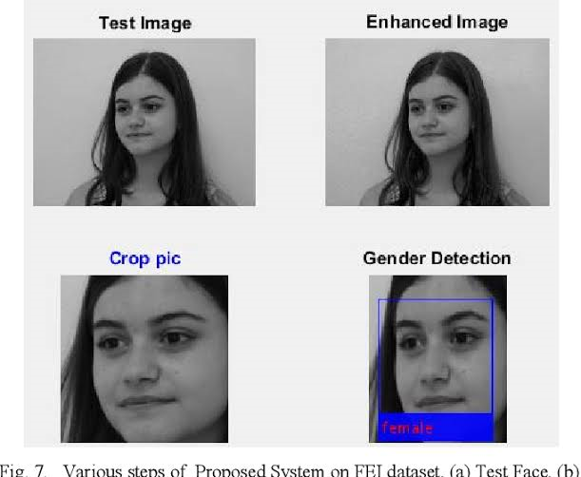
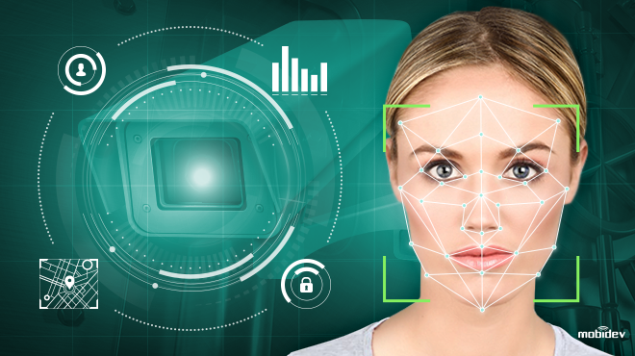
Introduction
Face recognition is a way of identifying or confirming an individual’s identity using their face.
Facial recognition systems can be used to identify people in photos ,videos, or in real-time.
Face recognition is one of the researches in area pattern recognition & computer vision.
Gender detection plays a significant role in modern technology. The detection of gender has many dynamic applications such as social interaction, security maintenance and surveillance,video games, human-computer interaction, etc.

Slide 4
PROBLEM STATEMENT
To recognize the face of a person also detect the gender of a person and keep a count on the number of visitors in the shopping Centre.
To be more precise,if the person’s face does not matches with the dataset present in the system,then it shows that the person is unknown and it will classify whether it is male or female and keep the count of it.

Slide 5
Literature Survey
Sr No. | Title | Authors | Publication/Journal /Year | Remark
1) | Face detection using Haar Based Cascade classifier and recognition using Principle Component analysis. | Sarala A. Dabhade & Mrunal S. Bewoor, [2012] | International Journal of Research in Advent Technology, 2019 | The goal is to implement the system (model) for a particular face and distinguish it from a large number of stored faces with some real-time variations as well.
2) | Facial expression recognition and gender classification using facial patches. | Anusha, A. V., J. K. Jayasree, Anusree Bhaskar, and R. P. Aneesh | International Conference on Communication System and Networks (ComNet), 2016 | In this paper, a novel method for facial expression recognition and gender classification based on the two expressions anger and joy along with geometric and appearance based method is proposed.
3) | Facial parts detection using Viola Jones algorithm. | V. K and Dr.S.Padmavath | International Conference on Advanced Computing and Communication Systems (ICACCS) | Numerous feature extraction algorithms in detecting the face detection have been suggested; however inadequate consideration has been given to the detection precision.
4) | Face Detection Based on Viola- Jones Algorithm applying composite feature | W. Y. Lu and M. Yang | International Conference on Robots & Intelligent System (ICRIS) 2019 | In this paper, we propose to apply the composite features based on Viola-Jones algorithm to generate the False detection of faces, and prove the feasibility of this method through experiments.
5) | Face Recognition and Counting using Raspberry Pi with IOT | Holkunde Monalisa,Veerbhadra Bale | Journal of engineering Science 2020 | This paper is focused on Face Recognition and Counting by using Raspberry Pi. To count the number of people in a selected area and recognition of faces to avoid duplicates is the main feature of the presented work.

Slide 6
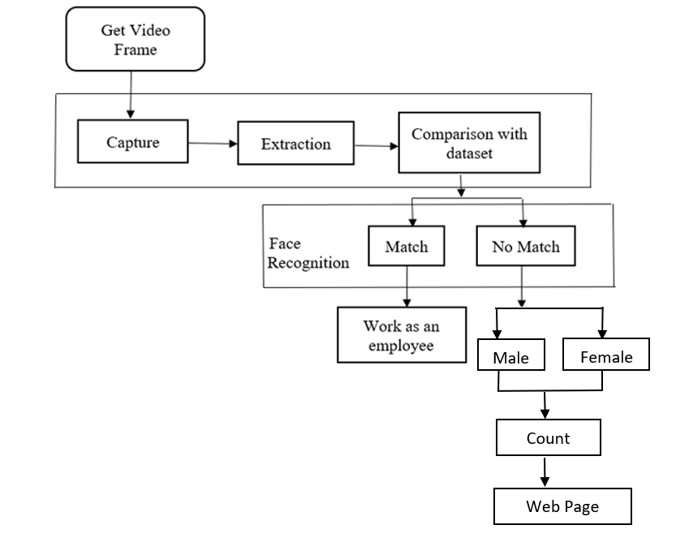
METHODOLOGY

Slide 7
Experimental Setup and working procedure:
The block diagram represented below mainly contains function modules, including a Capture module, an extraction module, a face detection module, and a people counting module.
1.) Input using Camera:-
The input images are captured from the Camera module which is connected through the Raspberry Pi Board .
2.) Face detection:-
•The captured images are converted into gray scale by using the RGB to gray scale conversion then finds its location on the coloured image.
• Then the images in binary format are applied to the face detector .
• The main purpose of face detection is to determine the facial area and non-facial area.
•In the Pre-processing stage white pixels are made whiter and black pixels are darker using contrast stretching.
•After pre-processing to detect a face in the image Viola-Jones Algorithm is used

Slide 8
3) Feature Extraction:-
Facial feature extraction locates important features like eyes, mouth, nose and eyebrows are in different positions within a detected Face.
The Haar-like features are used for the calculation of different facial features.It is calculated when the summation of all the feature values of a white pixel is subtracted from the sum of features in the dark pixels.
If the calculated value is more in any that of the region, the region is classified as eyes, nose, cheek etc.
4) Face Matching:-
Captured Image of a person compared with Known Dataset present in the System.
5) Face tracking and counting:-
If the Persons face does not match with the values listed in dataset then the system will thereby determine the recognized face as "unknown" and send a message containing "unknown" to the Android application (MQTT APP). The app will respond to a message and count that "unknown" value.

Slide 9
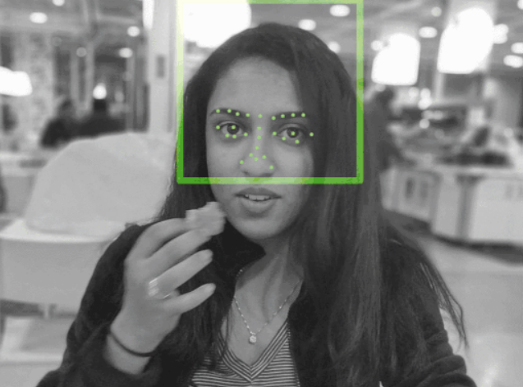
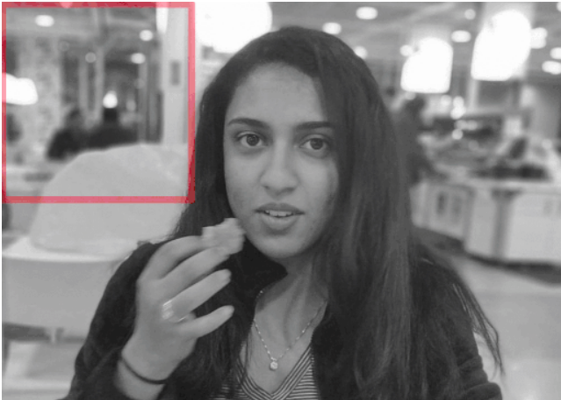
BACKEND WORK
HOW FACE RECOGNITION WORK ??
There are following stages in the Face Recognition Process:
1. Face Detection: A face detection technique is categorized into two parts that is feature-based approache and image-based approaches. The feature-based approach is used for feature analysis. While the image-based approach detects facial objects. It is the first step towards face recognition. First of all the input image is converted into a grayscale image and then finds its location on the coloured image. In the Pre-processing stage white pixels are made whiter and black pixels are darker using contrast stretching.
2. Viola-Jones Algorithm
After pre-processing to detect a face in the image Viola-Jones Algorithm is used. Viola-Jones method was chosen because it faster than other methods, high detection rate which is very high true-positive rate and a very low false-positive rate and it always runs real time.
Viola-Jones method is efficient on Frontal facial images and it sets the image with 45° face rotation in both vertical and horizontal axis.
3. Haar-like Feature : Haar-like features are virtual image features used in real-time face detectors. The Haar-like features are adaptable, four-sided rectangular frames that are used to compare white pixels with grey one. Edge features, Line features, and Four-rectangle features are three types of Haar features. Edge and Line features are useful for the determination of edges and lines in the image. For the detection of diagonal features, four-sided features are used.

Slide 10
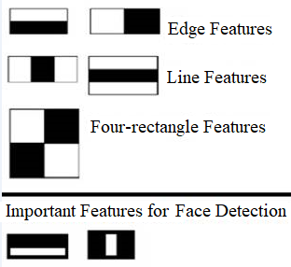
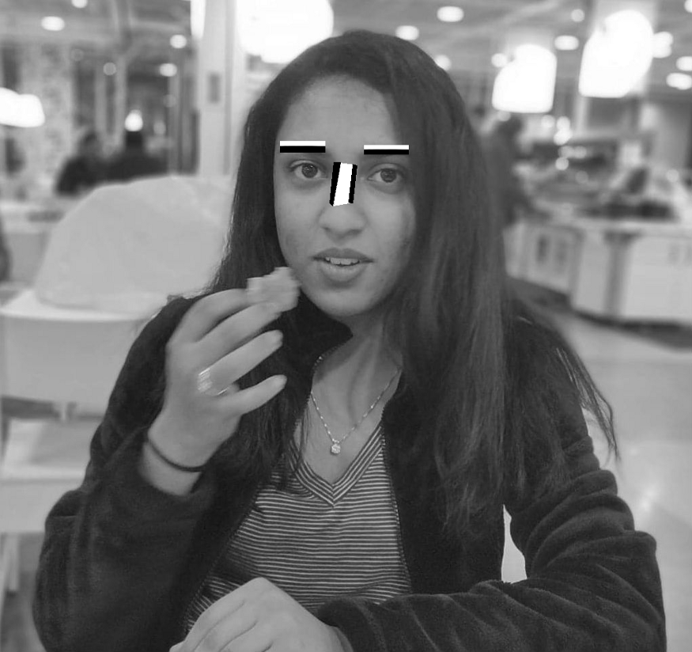
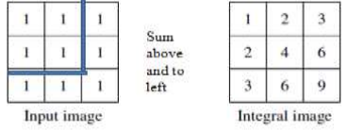
The Haar-like features are calculated when the summation of all the feature values of a white pixel is subtracted from the sum of features in the dark pixels. If the calculated value is more in any that of the region, the region is classified as eyes, nose, cheek etc.
F(Haar) = ∑ Fwhite − ∑ Fblack
4. Integral Image
Integral image allows for the calculation of sum of all pixels inside any given rectangle using only four values at the corners of the rectangle.
Image integral formula :
∑ 𝑖𝑖(𝑥, 𝑦) = 𝑖(𝑥′, 𝑦′𝑥′≤𝑥,𝑦′≤𝑦 )

Slide 11
BACKEND WORK
5. Adaptive boosting Algorithm: Adaboost algorithm integrates numerous “weak classifiers” into a single “strong classifier".It checks the performance of each classifier and used to avoid the complexity of calculation.
It is a machine-learning algorithm used to detect faces. The main purpose of face detection is to determine the facial area and non-facial area. After identification Adaboost allocates a weight to all of them.
6. Cascading : The cascade classifier eliminates non-faces, and provides accurate results. In cascading system identification of face is completed into multiple stages for the classification of the best feature. If all features are approved the image, is eventually it classified as a human face.

Slide 12
BACKEND WORK
Counting Part:
Step 1:live Images are captured by camera module .
Step 2:Camera continuously examine and outputting the image if a human face is found in the video frame .
Step 3:- Captured Image is then compared with Known Dataset present in the System.
Step 4:- If the Persons face does not Matches with the values listed in dataset then the name returned will be automatically designated as “Unknown” and send a message containing "unknown" to the Android application (MQTT APP). The app will respond to a message and count that "unknown" value.

Slide 13

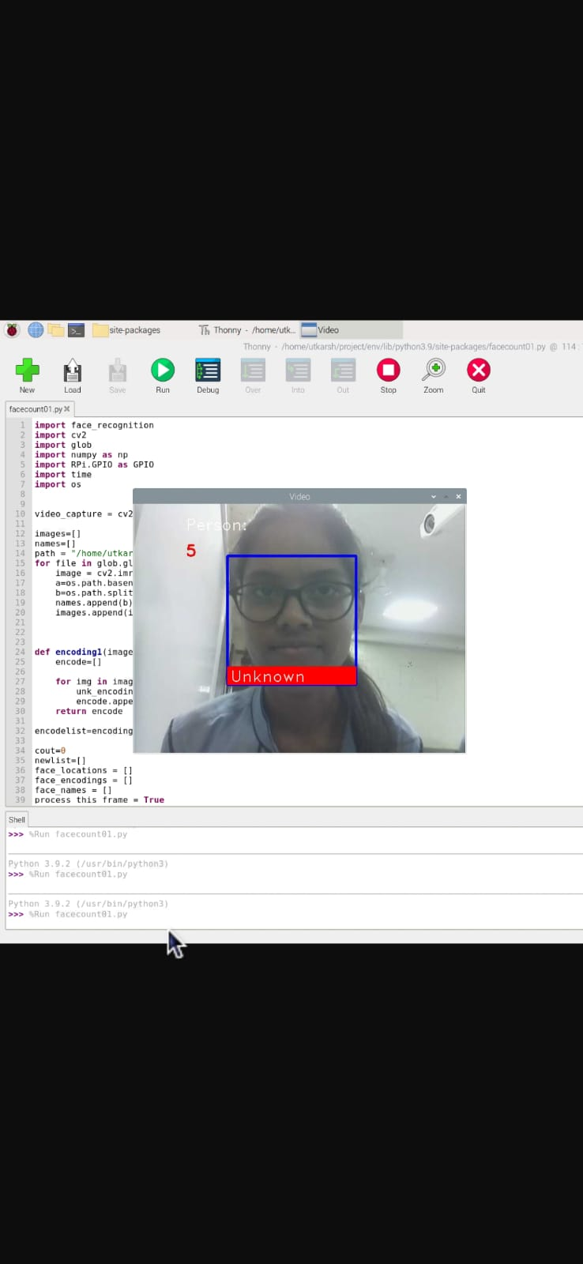
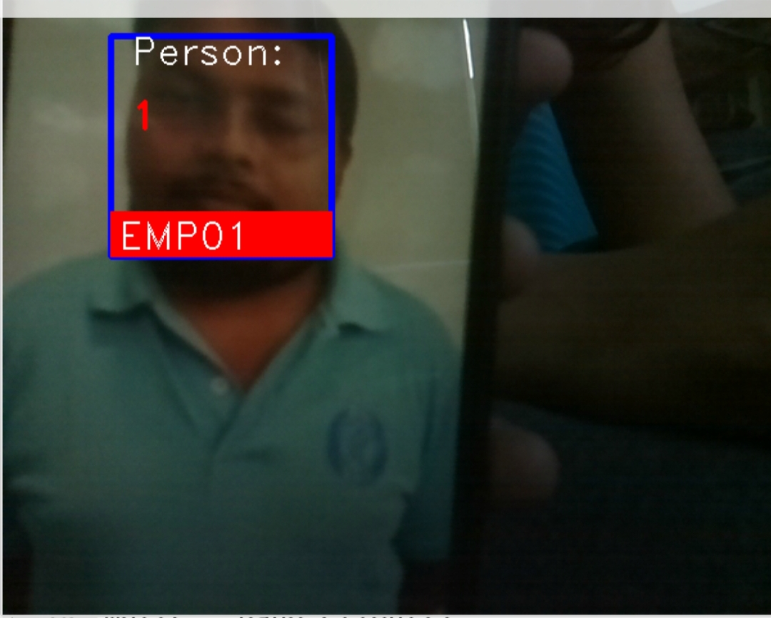

WORK DONE

Slide 14
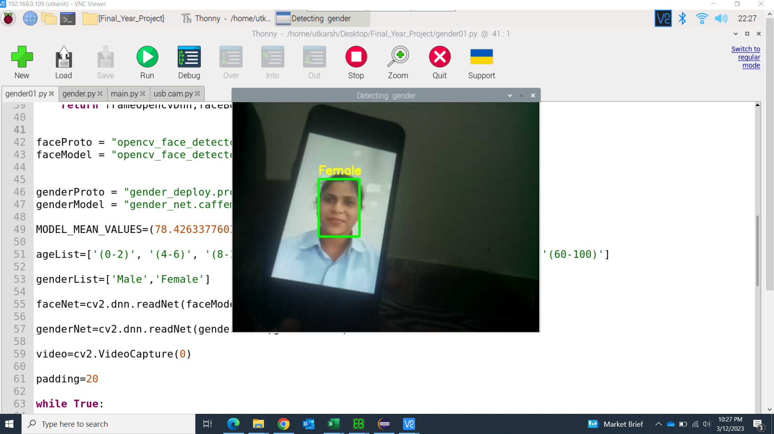
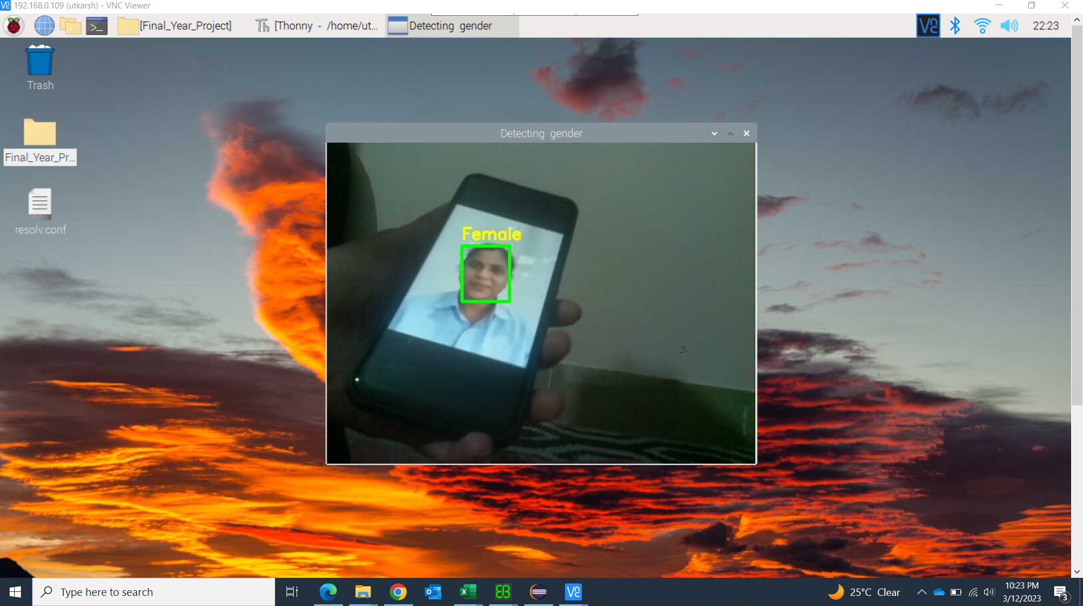
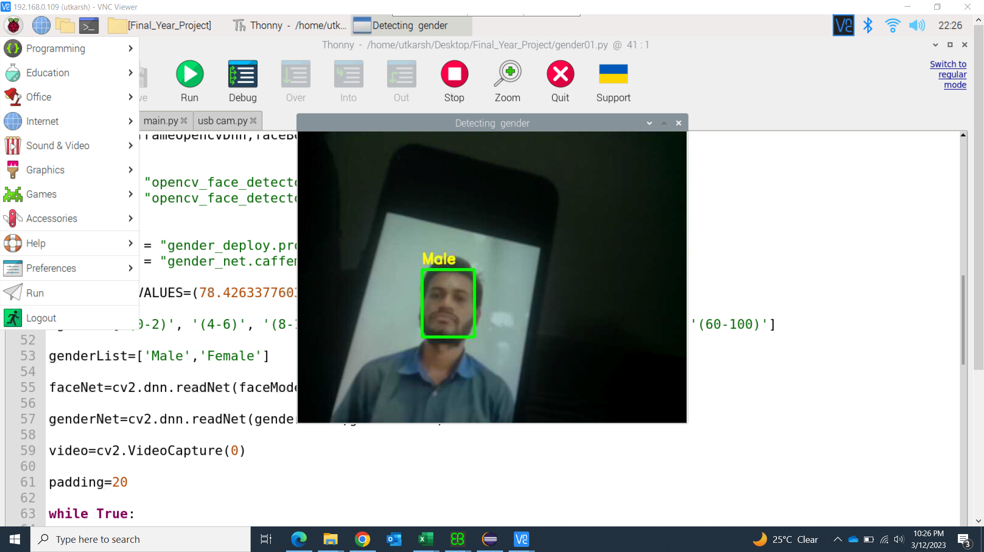
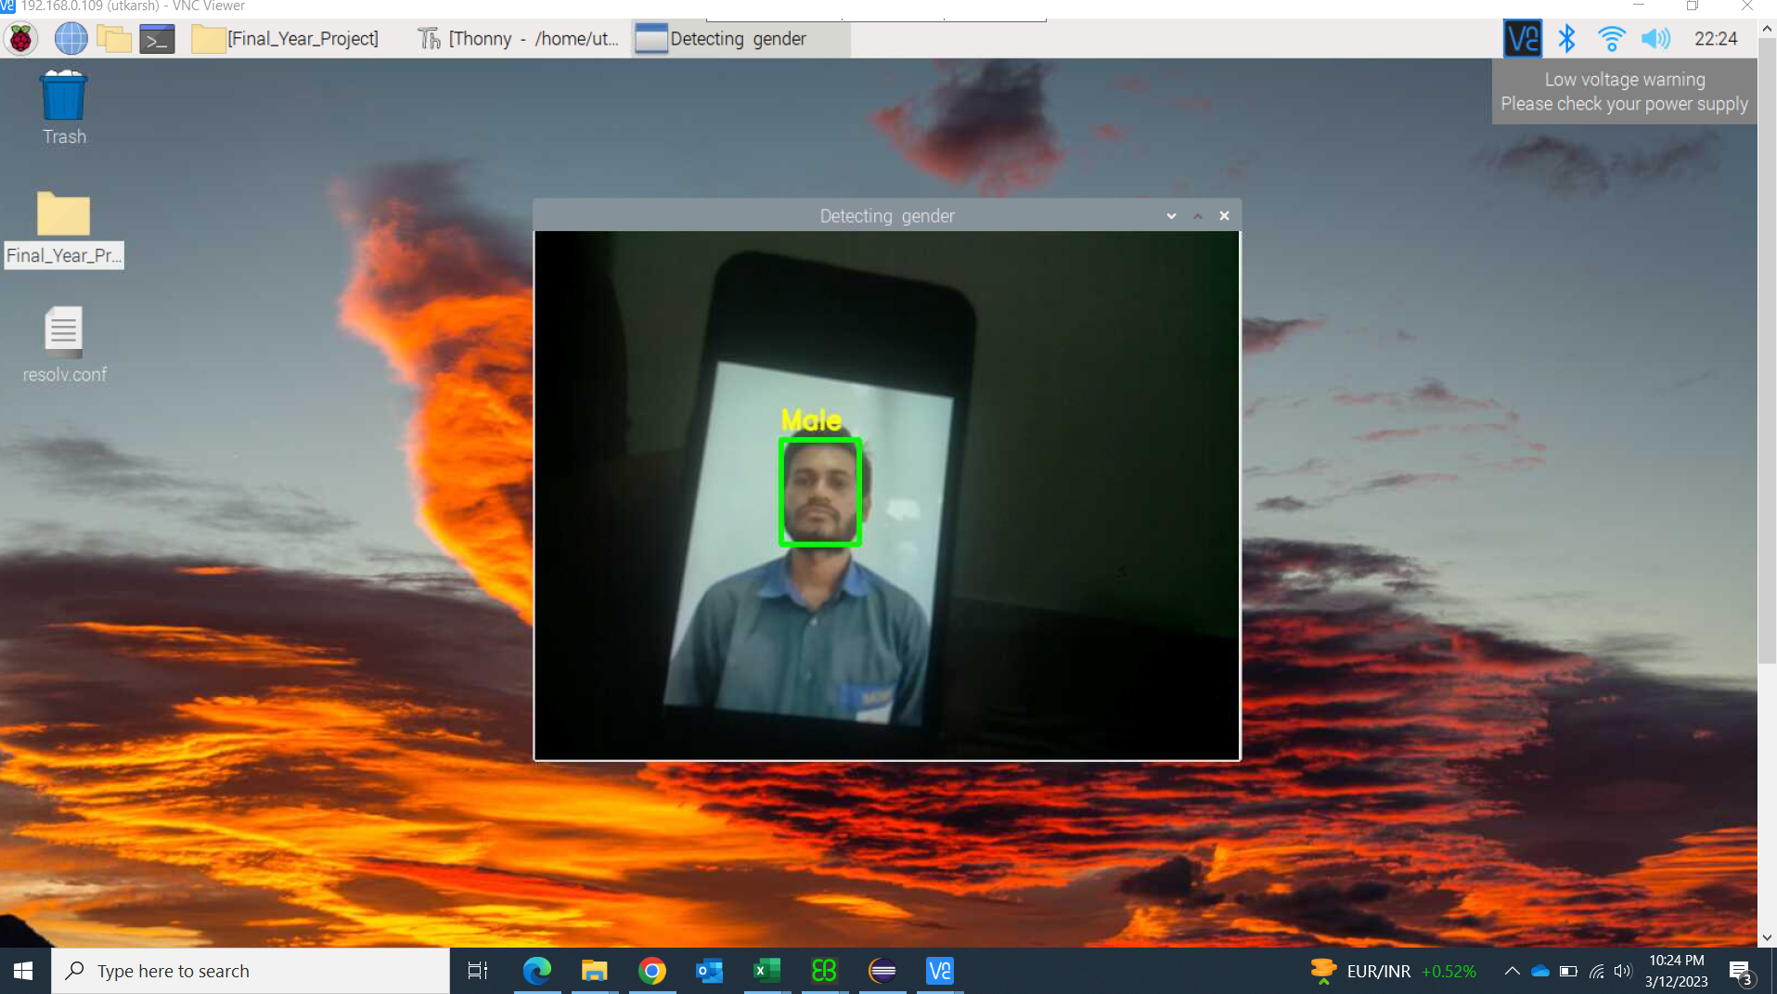
Work Done

Slide 15
References
[1]W. Y. Lu and M. Yang,”Face Detection Based on Viola- Jones Algorithm applying composite feature”, International Conference on Robots & Intelligent System (ICRIS),2019
[2]Mora Albiol -time high density people counter using morphological tools Systems, vol. 2, no. 4, pp. 204-218, Dec. 2001.
[3]T. H. Chen, T. Y. Chen and Z. X. Chen, "An Intelligent People-Flow Counting Method for Passing Through a Gate", 2006 IEEE International Conference on Cybernetics&Intelligent Systems (CIS),Bangkok, Thailand,pp.573-578, June 2006.
[4]Sarala A. Dabhade & Mrunal S. Bewoor , “Real Time Face Detection and Recognition using Haar - based Cascade Classifier and Principal Component Analysis”, International Journal of Computer Science and Management Research, Vol 1, No. 1.(2012)
[5]Anusha, A. V., J. K. Jayasree, Anusree Bhaskar, and R. P. Aneesh,“Facial expression recognition and gender classification using facial patches.”International Conference on Communication System and Networks,21-23 July 2016
[6]V. K and Dr.S.Padmavath ,”Facial parts detection using Viola Jones algorithm”, 4th International Conference on Advanced Computing and Communication Systems (ICACCS),06-07 January 2017
[7]Holkunde Monalisa,Veerbhadra Bale,”Face Recognition and Counting using Raspberry Pi with IOT”,Vol 11, No. 1, Jan 2020.Haar-like features.

Slide 16
THANK YOU

